Slide 1


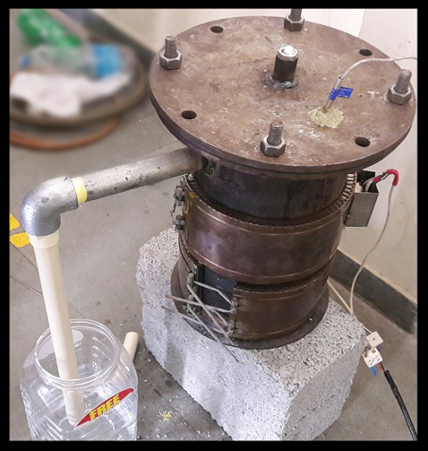
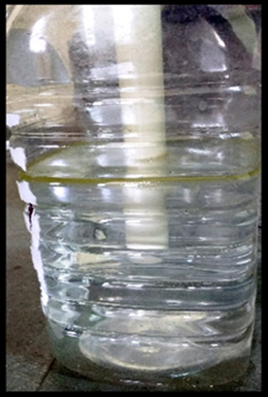
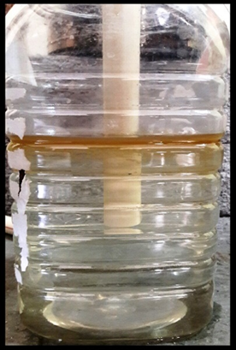
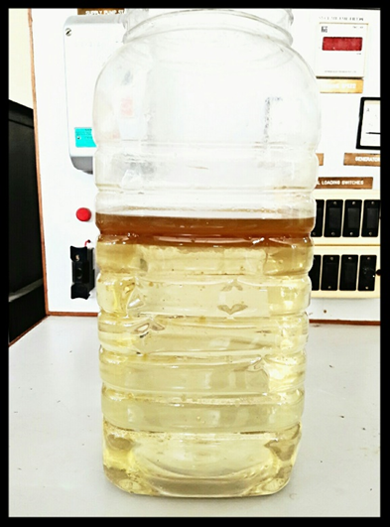
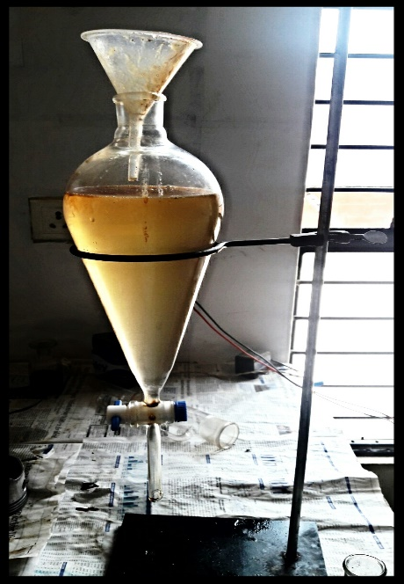
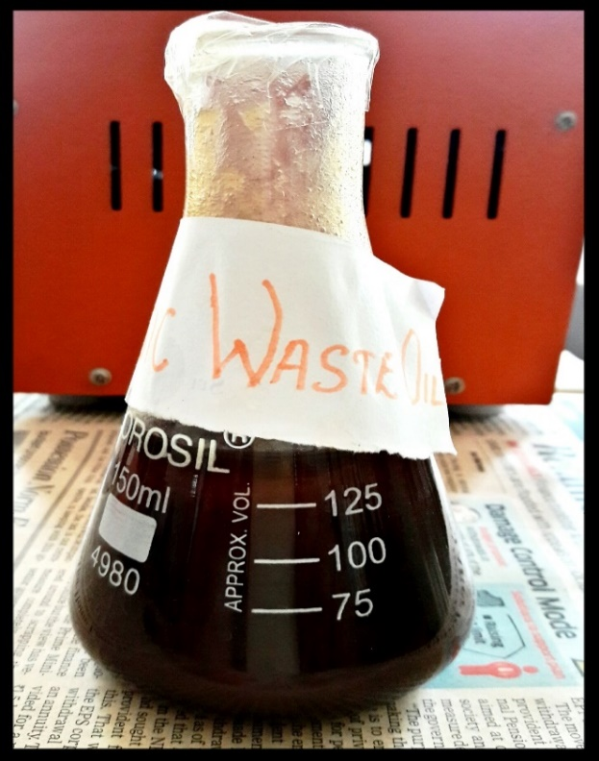
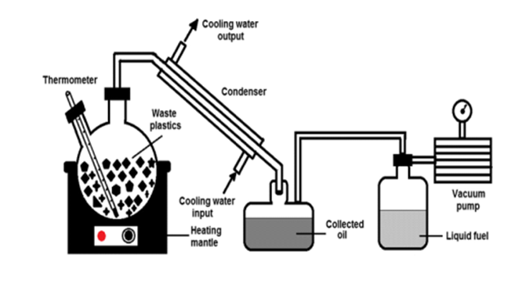
Technical Project Exhibition on
Design and fabrication of reactor for the extraction of fuel from waste plastic
By using pyrolysis process.
Yashas G M, Sumanth P, Rakesh K S, Vishnu H S, Ravi Y V
Department of Mechanical Engineering
Nagarjuna College of Engineering and Technology
Introduction
Extraction Process
Result
Plastic products have become integral part of our lives and play an irreplaceable role in day to day activities. It is impossible to imagine life without plastic and in other hand, production cause by plastic are become burning issues so from last few years, researchers, professors, environmentalist are very much interested in developing the technique for the management of solid waste.
Through the experimentation it concluded that about 300 to 450ml of diesel fuel could be obtained by burning 750gm of plastic.
Burning 750gm of plastic in an open environment produces 3Kg of CO₂, whereas by converting it into fuel and burning it reduces 80% of CO₂ emissions, which results in to be quite environmentally friendly.
Redesigned reactor for pyrolysis process
Initial condition before Condensation
Condensation of gas to obtain crude oil
After heating the waste plastic at a temperature of about 300⁰C to 500⁰C in the pyrolyzer the gas is allowed to escape through the outlet dipped into the water containing jar so as to condense the fumes to obtain the RAW FUEL floating over the surface as shown in picture below , which is further taken out through the outlet provide to the water containing jar.
Physical properties of waste plastic oil
Scope of the Project
Properties | Waste plastic oil
Density at 30⁰C (in g/cm³) | 0.874
Kinematic Viscosity (Centistokes) | 4.31
Flash point (in ⁰C) | 107
Fire Point (in ⁰C) | 118
The present rate of economic growth is unsustainable without saving of fossil energy like crude oil, natural gas, or coal.
There are many alternatives to fossil energy such as biomass, hydropower, and wind energy. Also, suitable waste management strategy is another important aspect.
Scope For Future Work
The obtained fuel could be utilized in diesel generators, vehicles such as tractors and also passenger vehicles such as cars.
The application of this project could help in reducing the dependency on the gulf countries and promote a step towards innovation.
Methodology
The pyrolysis is a simple process in which the organic matter is subjected to higher temperature about 150ºC to 200ºC in order to promote thermal cracking of the organic matter so as to obtain the end products in the form of – liquid, char and gas in absence of oxygen.
A layer of oil formed at the top surface after Condensation of the gases.
Crude oil collected from about 750gm of Plastic.
Conclusion
Crude oil from waste plastic were obtained, and physical properties of waste plastic oil are tabulated above.
Sedimentation
Final Raw fuel collected after separated it from water.

